Slide 1
Telehealth Trends During the COVID-19 Pandemic
AI Boot Camp Project 1
Team Members:
Darcy Debord
Desalegn Bekele
Robert Rodriguez

Slide 2
Project Overview
Project Purpose / Description
Telehealth Trends During the COVID-19 Pandemic
This project investigates the impact of the COVID-19 pandemic on telehealth services. The focus is on understanding how telehealth usage patterns changed before, during, and after the height of the pandemic, examining data across different states, demographics, and time periods
Notes:
Robert

Slide 3
Project Overview
Goals/Questions to be addressed
What was the rate of telehealth adoption during the COVID-19 pandemic?
This question focuses on quantifying the increase in telehealth usage from the onset of the pandemic, aiming to provide a clear picture of how healthcare service delivery evolved in response to global health challenges

Slide 4
Project Overview
Goals/Questions to be addressed
Who was using telehealth services?
Demographic analysis was crucial to understand which population segments were most engaged with telehealth. This involved looking at different age groups, socioeconomic status, and other relevant demographic factors to identify trends and disparities in telehealth usage.

Slide 5
Project Overview
Goals/Questions to be addressed
Where were users located?
Geographic trends in telehealth adoption were also studied to ascertain whether there were significant trends in usage across different states.

Slide 6
Project Overview
Overview of data collection, cleanup and exploration process
Standardizing Time
The initial step in our analysis involved unifying the time period formats across all datasets. Data was collected from the CDC website, where each dataset had its unique way of representing time. To facilitate consistent temporal analysis across all data, we standardized all time references to a uniform format of year and quarter (e.g., 2021 Q1). This standardization was crucial for aligning datasets for comparative and trend analyses over time.

Slide 7
Project Overview
Overview of data collection, cleanup and exploration process
Harmonizing Shared Information
After standardizing the time periods, we focused on examining the common fields across the datasets collected from the CDC. This included demographic information and geographical data, which varied slightly in terms of categorization and standardized terminology across different datasets. We standardized these attributes to ensure consistency in definitions and categories used throughout our analysis. This harmonization was essential for integrating the datasets to form a comprehensive view of the data.

Slide 8
Project Overview
Overview of data collection, cleanup and exploration process
Removing Skewed Data
During our data cleaning process, we identified entries that could potentially skew the analysis results, such as 'National' being listed under the state column. These entries were promptly removed to maintain the integrity of geographic-specific analyses and ensure accuracy in the interpretation of trends. This step was particularly important to avoid misleading conclusions in our study of geographic variations in telehealth adoption.
Notes:
These structured steps in data preparation—standardizing, harmonizing, and cleaning—allowed us to conduct a thorough and reliable analysis of telehealth adoption during the COVID-19 pandemic, based on the robust data collected from the CDC.

Slide 9
Project Overview
Approach taken to achieve goals
Approach
The approach for this study involved gathering relevant datasets on telehealth usage, COVID-19 cases, demographics, and healthcare infrastructure. These datasets were integrated to create a unified dataset for analysis. Exploratory data analysis was conducted to identify trends and correlations, specifically focusing on the impact of the pandemic on telehealth adoption. Visualizations such as line charts, bar graphs, and heatmaps were created to present key findings. The results were interpreted to draw meaningful conclusions and provide actionable recommendations.

Slide 10
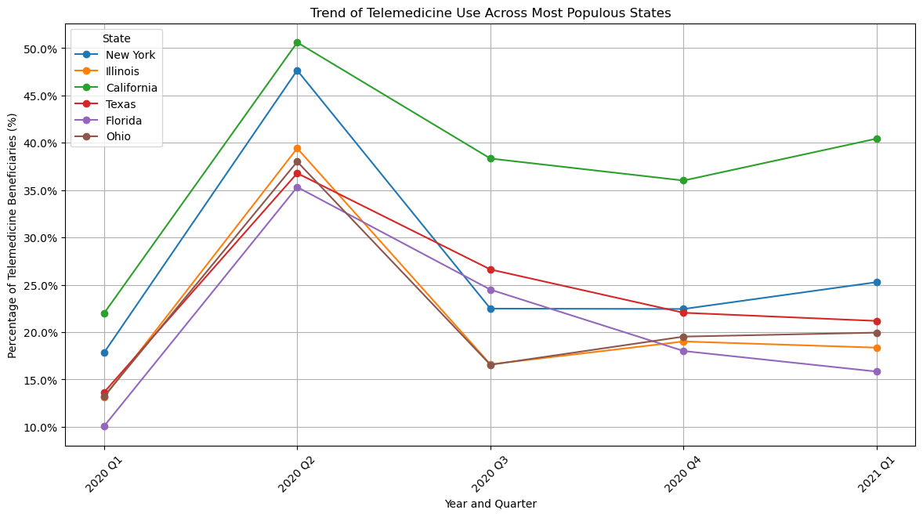
Regional Disparities
Our group searched blue and red states, blue states, which typically have higher rates of healthcare coverage and more robust telehealth infrastructure, have seen a greater increase in telehealth usage during the COVID-19 pandemic compared to red states. Red states have faced challenges in expanding telehealth services due to lower rates of healthcare coverage and limited resources, leading to disparities in access to healthcare services. Addressing these disparities is crucial in ensuring all Americans have access to quality healthcare services during public health emergencies like the COVID-19 pandemic.

Slide 11
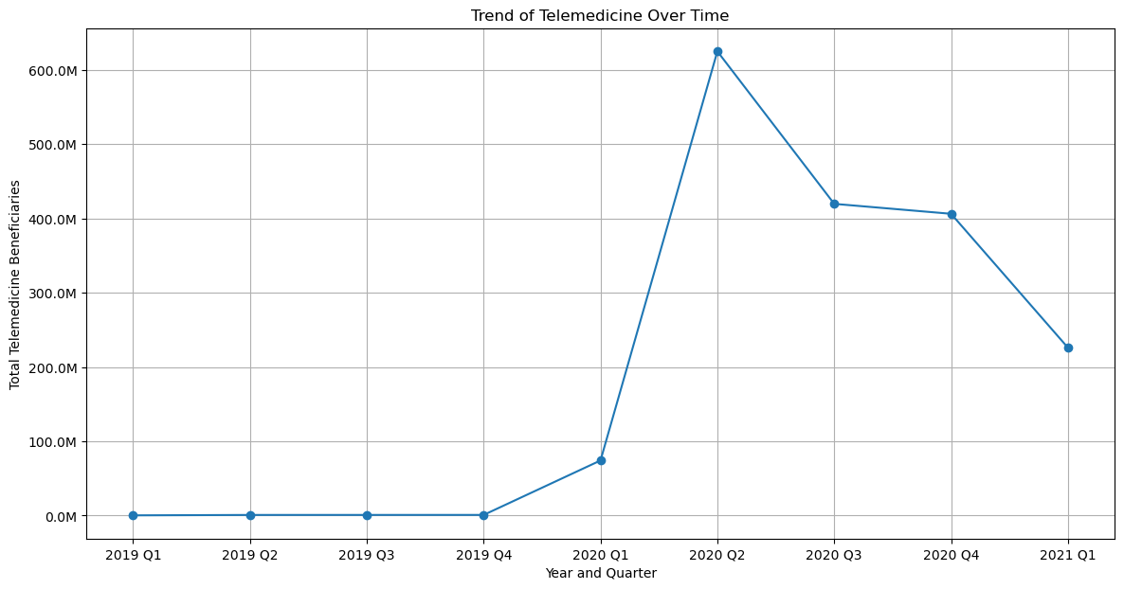
Result/Conclusion 1
Telehealth adoption during the COVID-19 pandemi

Slide 12
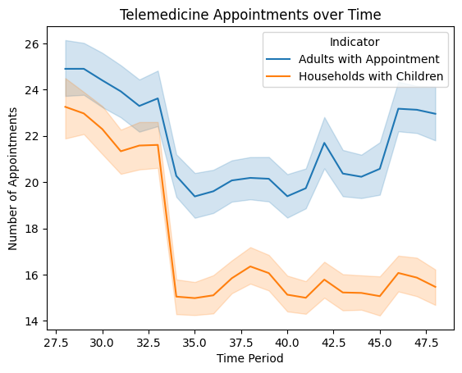
Result/Conclusion 1
Use of Telehealth after the pandemic
by Indicator Value

Slide 13
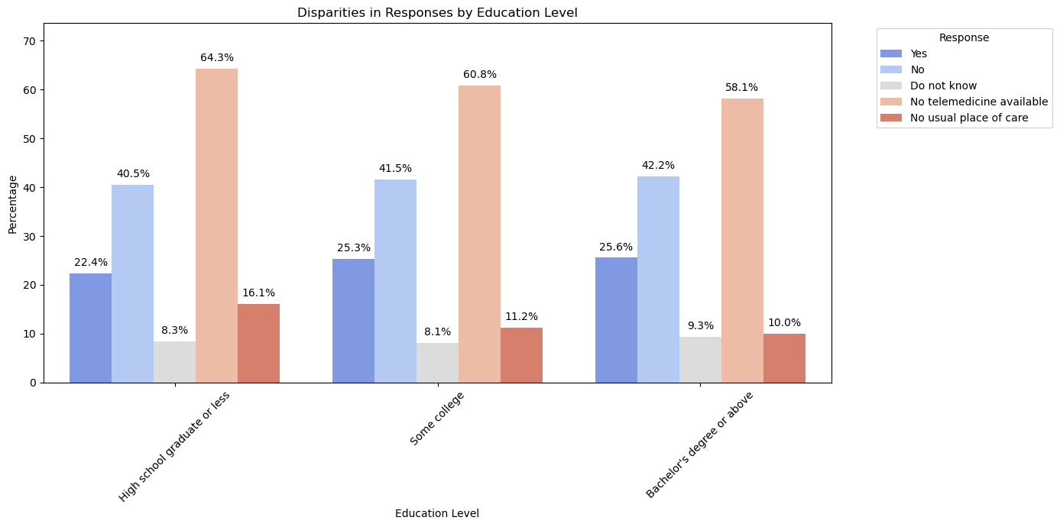
Result/Conclusion 2
Disparities in Response
by Education Level

Slide 14
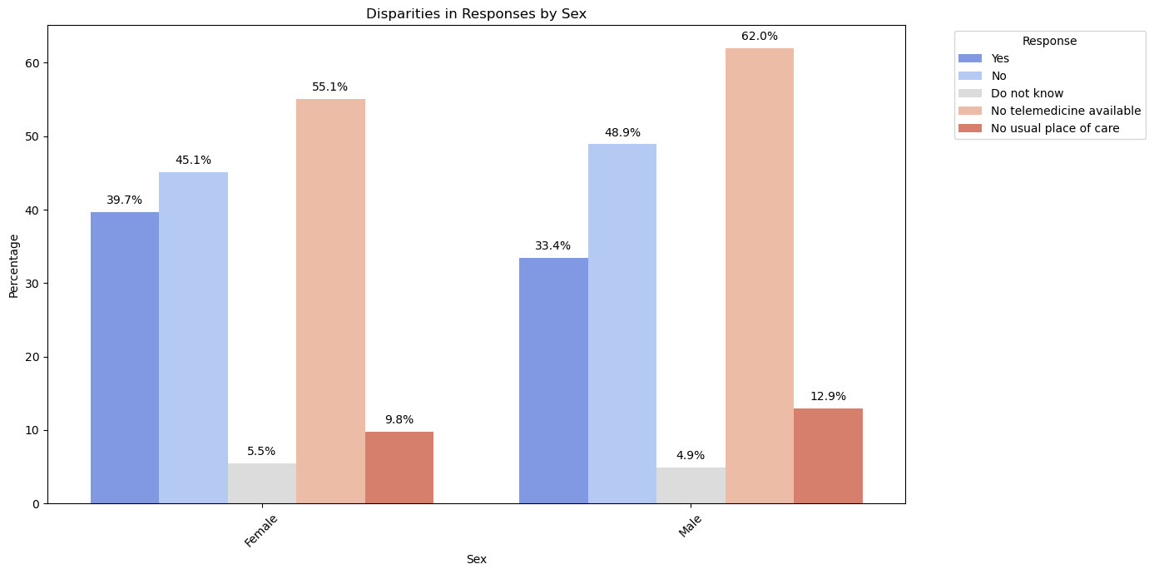
Result/Conclusion 3
Disparities in Response
by Sex

Slide 15
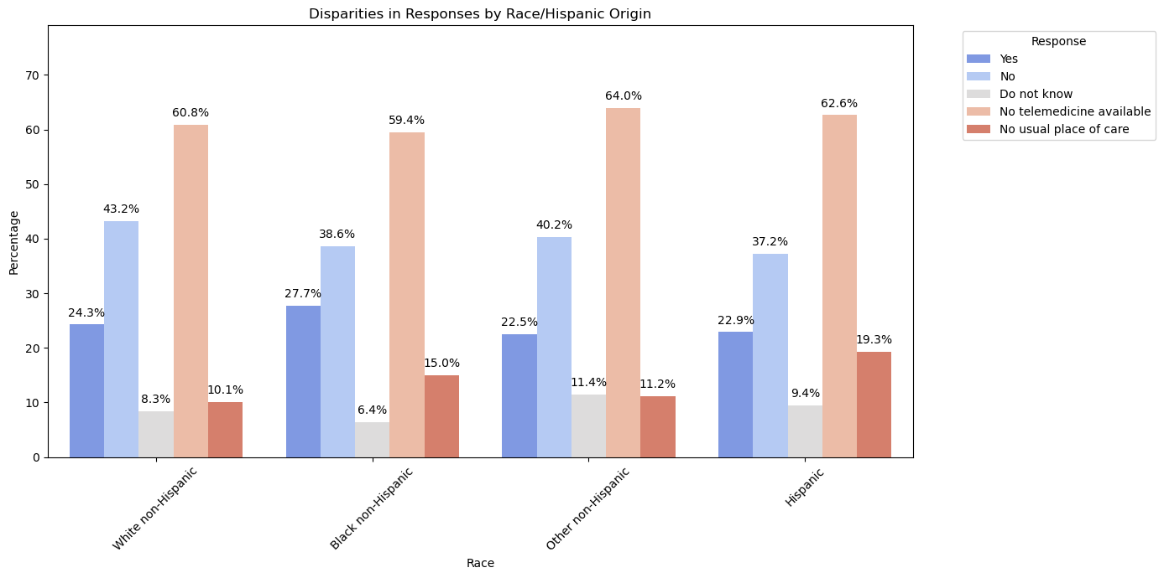
Result/Conclusion 4
Disparities in Response
by Race

Slide 16
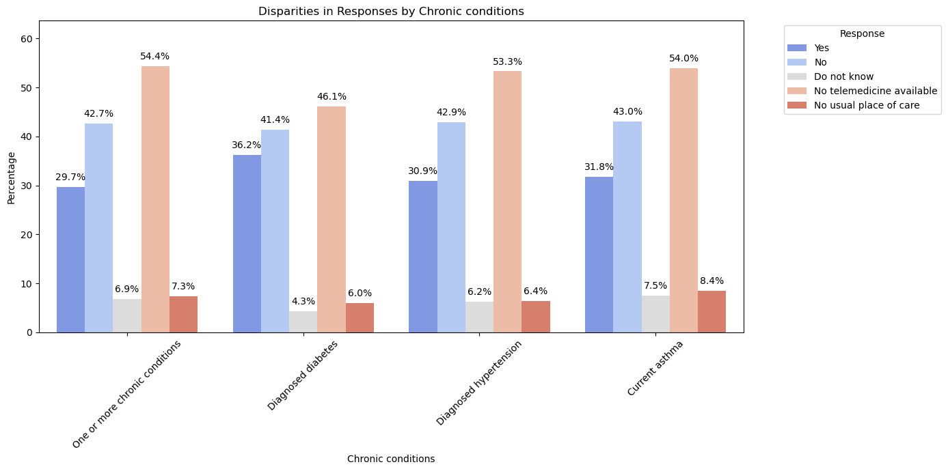
Result/Conclusion 5
Disparities in Response
by Chronic Conditions

Slide 17
Result/Conclusion 6
Trend of Telemedicine Across Most Populous States

Slide 18
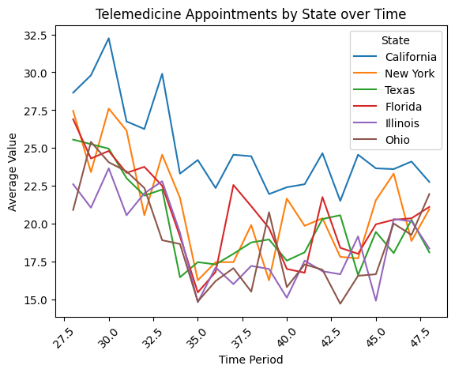
Result/Conclusion 7
Trend of Telemedicine Across Most Populous States by Confidence Indicator

Slide 19
The analysis revealed that the COVID-19 pandemic had a transformative impact on the adoption of telehealth, accelerating its usage across various demographic and geographical segments. While usage peaked during the strictest lockdown phases, it stabilized at a higher baseline than pre-pandemic levels, suggesting a lasting change in how healthcare services are delivered. Future policies and healthcare planning will need to consider these changes to effectively integrate telehealth services into standard care practices.
Summary
Moreover, the findings suggested that the increased adoption of telehealth was not merely a temporary response to the pandemic but rather a fundamental shift in healthcare delivery practices. Usage levels stabilized at a higher baseline than pre-pandemic levels even as restrictions eased, indicating a sustained preference for telehealth services among patients and healthcare providers alike.
Furthermore, as telehealth becomes an integral part of healthcare delivery, efforts should be made to ensure equitable access to these services across all demographic and geographical segments. Addressing barriers to access, such as digital literacy, technological infrastructure, and reimbursement policies, will be crucial in ensuring that telehealth services reach all populations, including those in underserved and rural areas.
In conclusion, the data underscores the importance of recognizing telehealth as a critical component of modern healthcare delivery. Embracing telehealth not only enhances access to care but also offers opportunities for more efficient and patient-centered healthcare delivery models in the post-pandemic era.

Slide 20
Data Availability: The availability of comprehensive and reliable data for all relevant indicators and time periods was a challenge. In some cases, certain indicators or time periods had missing or incomplete data, which impacted the analysis and visualization.
Data Formatting: The formatting of date/time columns varied across different datasets, requiring preprocessing steps to ensure consistency and compatibility for analysis and visualization.
Data Visualization: Designing informative and visually appealing visualizations posed challenges, especially when dealing with large and complex datasets. Selecting the most appropriate chart types, color schemes, and labeling formats to convey the key insights effectively required careful consideration.
Data Presentation: Presenting the data in a clear, concise, and understandable manner for diverse audiences posed challenges. Balancing the level of detail with simplicity, and choosing appropriate visualization techniques to highlight key findings, required careful planning and execution.
Problems Encountered

Slide 21
Future Research and Development Plans
If more time was available the group might research the evolution and history of telehealth and we may explore the development of telehealth technologies and their benefits and advantages in specific healthcare settings. We may also investigate the cost-effectiveness of telehealth implementation and its impact on global healthcare, particularly in light of the COVID-19 pandemic. Additionally, we may examine cultural, social, and economic factors that influence the adoption and success of telehealth, considering how these factors can shape the future of telehealth services.
Future Considerations

